Slide 1

CUI Abbottabad
Department of Computer Science
SRE
12
Functional Requirements

Slide 2
Outline
Exploring and Specifying Internal Quality Attributes
Conflicts

Slide 3



Slide 4
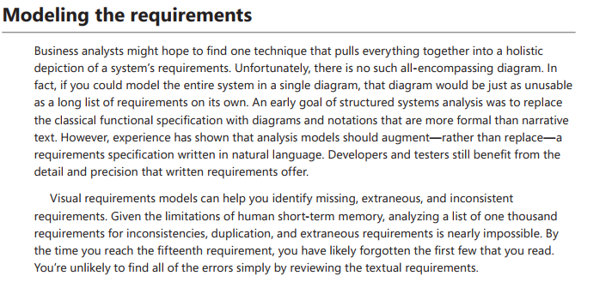

Slide 5
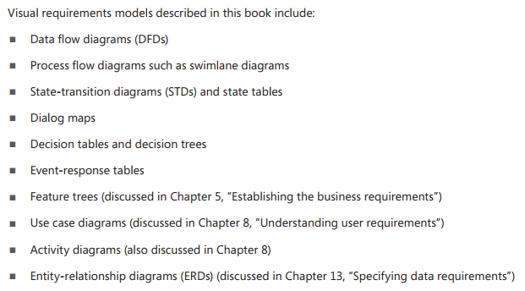

Slide 6


Slide 7
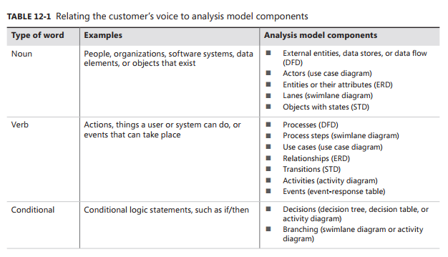

Slide 8
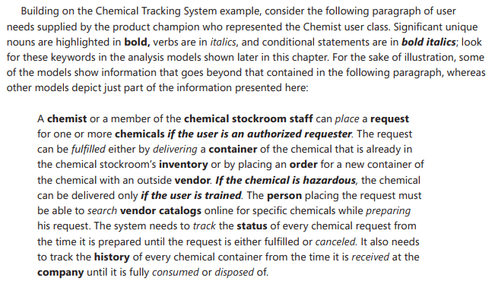

Slide 9
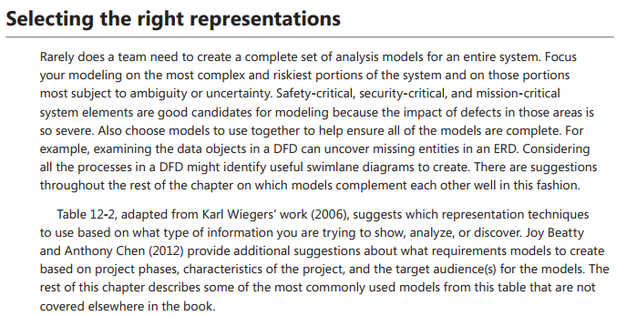

Slide 10
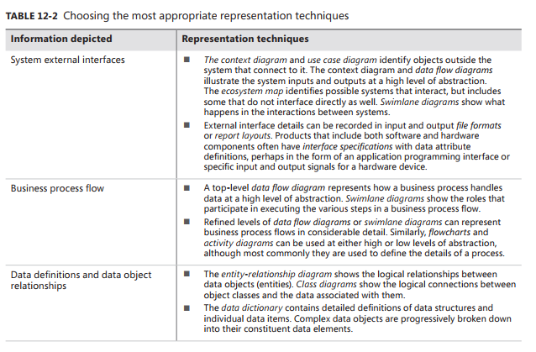

Slide 11
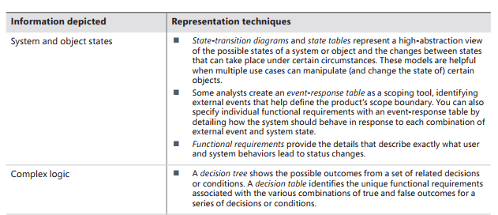

Slide 12
